Slide 1
Purple Haze
CSE 583
Final Presentation
12-16-2020
Tyler Cox
Carley Fredrickson
Greta Shum
Adam Sokol

Slide 2
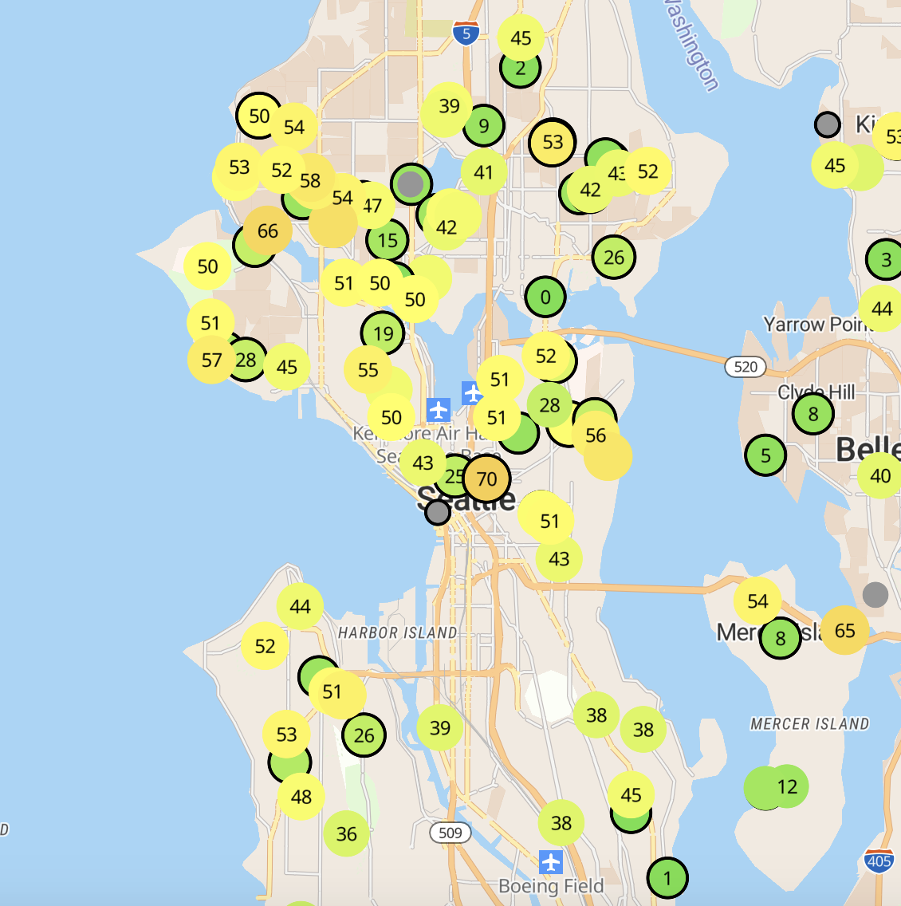
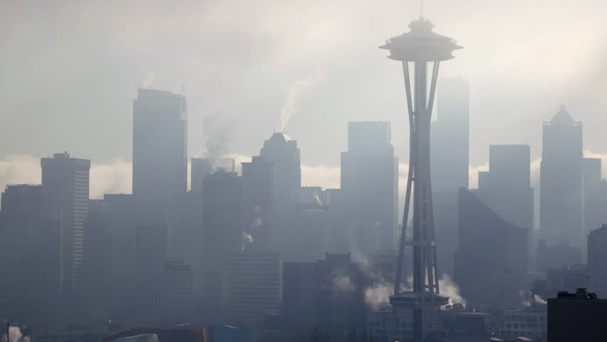
MOTIVATION
How are Purple Air sensors distributed across Seattle?
How does air quality around Seattle correlate with socioeconomic indicators?

Slide 3


Data
Purple Air
Six months of hourly PM2.5 data from every sensor in Seattle
Seattle Racial & Social Equity Composite Index
Several socioeconomic metrics for every census tract in the city.

Slide 4
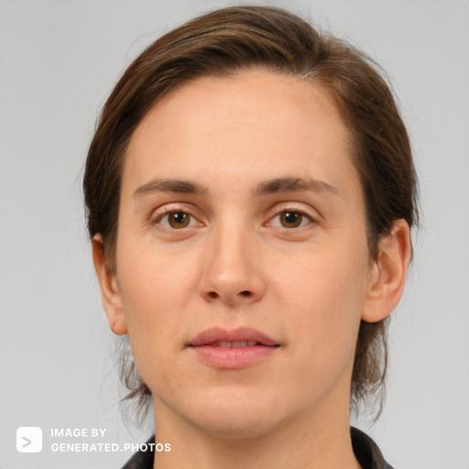

Use Case #1
Determine where Purple Air sensors are being purchased and installed in Seattle
Discover demographic info about where sensors are being installed
Use Case #2
Study hyper-local variability in Seattle’s air quality
Assess relationships between air quality and socioeconomic indicators

Slide 5
Repo Structure
purple_haze repository
purple_haze
docs
examples
data
environment.yml
setup.py
lab_extensions.sh
user interface
(jupyter notebook)
tests
module code
purple air
city of seattle
figures.py
matcher.py
air.py
Notes:
-Emphasize where jupyter notebook is

Slide 6

Short Demo
Notes:
Our product startup has not changed, but our product design and functionality has. Here is a quick demo highlighting those updates. (1 minute video)

Slide 7
Lessons Learned
Not always easy to determine when to rely on error catching of your underlying packages vs when to write your own
Learned to write useful error messages based on what’s likely to need to be changed specifically in the world of this project
Try to use a single package for visualization as mixing packages is not guaranteed to work
Only include packages you manually import in the virtual environment

